Slide 1
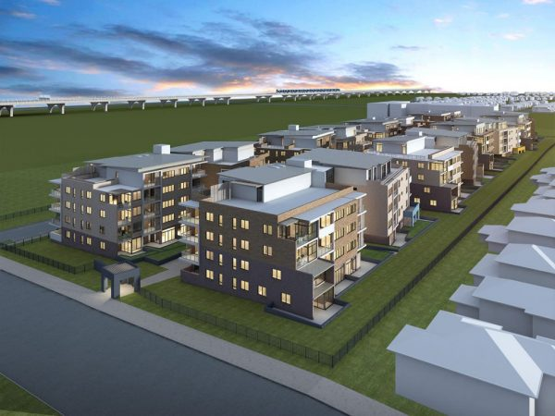
House Price Prediction Project
By
KOUSHIK BISWAS

Slide 2
TABLE OF CONTENTS
Abstruct
Introduction
Problem Statement
Conceptual Background of the Domain Problem
Data Sources and their formats
About The DataSet
Data Preprocessing
Hardware and Software Requirements and Tools Used
selected models
Accuracy score of the model
Parameter tuning
Final model
Visualizations
Interpretation of the Results
Conclussion

Slide 3
Abstruct
.
Housing prices are an important reflection of the economy, and housing price ranges are of great interest for both buyers and sellers. In this project, house prices will be predicted given explanatory variables that cover many aspects of residential houses. The goal of this project is to create a regression model that is able to accurately estimate the price of the house given the features

Slide 4
Introduction
Thousands of houses are sold everyday. There are some questions every buyer asks himself like: What is the actual price that this house deserves? Am I paying a fair price? In this paper, a machine learning model is proposed to predict a house price based on data related to the house (its size, the year it was built in, etc.). This will facilitate the reproducibility of our work. In this study, Python programming language with a number of Python packages will be used.

Slide 5
Problem Statement
Houses are one of the necessary need of each and every person around the globe and therefore housing and real estate market is one of the markets which is one of the major contributors in the world’s economy. It is a very large market and there are various companies working in the domain. Data science comes as a very important tool to solve problems in the domain to help the companies increase their overall revenue, profits, improving their marketing strategies and focusing on changing trends in house sales and purchases. Predictive modelling, Market mix modelling, recommendation systems are some of the machine learning techniques used for achieving the business goals for housing companies. Our problem is related to one such housing company. A US-based housing company named Surprise Housing has decided to enter the Australian market. The company uses data analytics to purchase houses at a price below their actual values and flip them at a higher price. For the same purpose, the company has collected a data set from the sale of houses in Australia. The company is looking at prospective properties to buy houses to enter the market. I have to build a model using Machine Learning in order to predict the actual value of the prospective properties

Slide 6
Conceptual Background of the Domain Problem
we are going to work on a dataset which consists information about the location of the house, price and other aspects such as square feet etc. When we work on these sorts of data, we need to see which column is important for us and which is not. Our main aim today is to make a model which can give us a good prediction on the price of the house based on other variables. We are going to use Linear Regression for this dataset and see if it gives us a good accuracy or not.

Slide 7
Data Sources and their formats
I have imported the dataset which was in the csv file using pandas. The dataset contains 1168 rows and 81 columns having both numerical and categorical data. Here I can make use of PCA to reduce the columns, but this will give huge data loss. To avoid this, I am keeping the dataset as it is.
In this dataset " SalePrice" is our target variable which has float values. So this is a "Regression type" problem.
you can download the dataset from the below link.
Dataset link:
https://github.com/KBkoushik/Housing-Project/blob/40e17dec4167b9b02d89187abadc1d0748c860d0/house%20price%20prediction%20train%20data.csv

Slide 8
About The DataSet
Please visit the link to know more about dataset
  https://github.com/KBkoushik/Housing-Project/blob/053de3656f009dc77ac60679cad247ee9553939b/Data%20Description%20Of%20Housing%20Project.txt

Slide 9
Data Preprocessing
For the purpose of the project the dataset has been preprocessed as follows:
• we can see 50% or more data are missing in some columns .so we dropped this column to get a better analysis of the data.
• we divide all the columns into categorical and numerical types
• Univariate Analysis Of Categorical Columns and numerical columns.
• Drop ID column
• Drop the utility column to save one type of value.
• Checking correlation with target column using Heatmap
• Checking skewness of each columns
• Handling missing value
• Checking Outliers and removing outliers by zscore
• Encoding the categorical column by Label Encoder
• Dividing data into features and vectors
• Checking VIF score
• Removing skewness by power transform method
• Standardizing the data by standard scaler

Slide 10
Hardware and Software Requirements and Tools Used
Hardware:- Desktop/Laptop
Software:- Anaconda

Slide 11
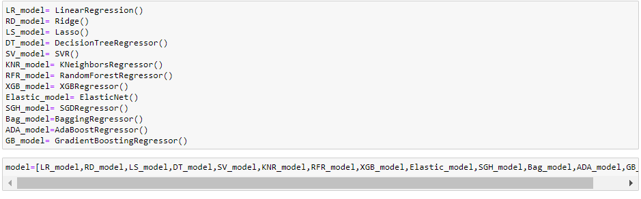
selected models
I used 13 different regression algorithms to get the ideal one for prediction.

Slide 12
Accuracy score of the model
Model Name | Accuracy Score
LinearRegression | 0.9157549306982217
Ridge | 0.9156381232585454
Lasso | 0.9156585091398327
DecisionTreeRegressor | 1.0
SVR | 0.04195953923971785
KNeighborsRegressor | 0.8885605760360096
RandomForestRegressor | 0.9845258531878339
XGBRegressor | 0.9999935817822405
ElasticNet | 0.8997077125798796
SGDRegressor | 0.9140697002146222
BaggingRegressor | 0.9783117379249365
AdaBoostRegressor | 0.9139360964002511
GradientBoostingRegressor | 0.9780245165765798

Slide 13
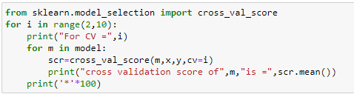
Cross Val Score
After Runing this code we get best cross val score from GradientBoostingRegressor for CV=3

Slide 14
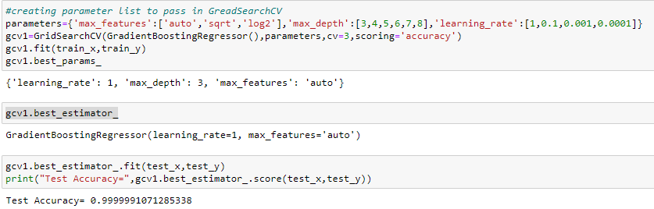
Parameter tuning
accuracy score has increased after parameter tuning.Now we will create final model with this parameter.

Slide 15
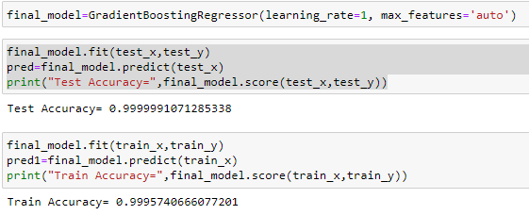
Final model
since difference between train accuracy and test accuracy is very less ,our final model is not overfit or underfit.

Slide 16
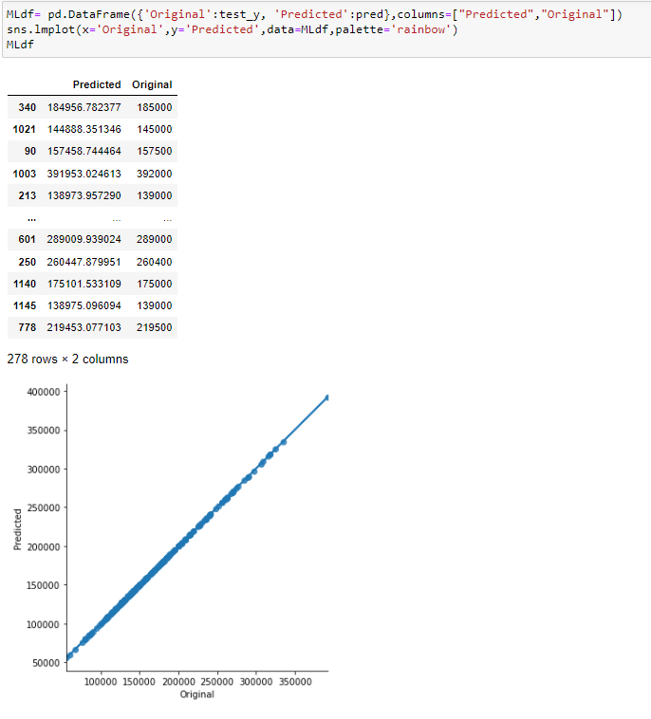
Visualizations
We can see that the original house price and final model’s predicted price are almost same which means model performance is good

Slide 17
Interpretation of the Results
This particular problem needs a good vision on data, and in this problem Feature Engineering is the most crucial thing.
You can see how we have handled numerical and categorical data and how we build different machine learning models on the same dataset.
It is always advised to all of us that atleast we need to use 5 Algorithm in order to figure out which one is performing best among them and we choose that one and we send that for hyper parameter tuning to know that best parameter .
Using hyper parameter tunning we can improve our model accuracy, for instance in this model the accuracy increased.

Slide 18
Future Work
For future improvements, following step we thought to took-
  Replacing model with a latest/different model
  Using other robust datasets
  Predicting result on differents attributes

Slide 19
Conclussion
When predicting house prices, many complications were involved. There are many variables / attributes to consider in determining the price of a house and if all or most of them are used, we need a lot of calculating power to get the price of the house. And it is very difficult to accurately predict home prices in real life.
For any of machine learning project my suggestion is first you have to understand the problem on ground level .if you don’t allow yourself to work with diligence .if you don’ t work harder anything that you are doing or will do , not only in case of machine learning but also in life cycle would be futile. Maybe, my endeavour assist you when ever you will get stuck

Slide 20
THANK YOU

